Slide 1
Department of Computer Science
CS F364 – DESIGN AND ANALYSIS OF ALGORITHMS
LECTURE –APPROXIMATION ALGORITHMS, ABSOLUTE APPROXIMATION
PORTIONS: As specified in handout and the contents taught in class. Class notes is must. Refer to the textbook as mentioned in handout
PLEASE NOTE THAT PPT IS JUST AN ADDITIONAL REFERENCE.

Slide 2
Approximation Algorithms
Absolute Approximation
Planar Graph Coloring,
Maximum Programs Stored Problem

Slide 3
Approximation Algorithm
A feasible solution with value close to the optimal solution is called Approximate Solution and the algorithm that generates approximate solution for the problem P, is called as an Approximation Algorithm.
To produce an algorithm of low polynomial time complexity, it is necessary to relax the meaning of “solve”. These relaxations are :
We remove the requirement that the algorithm that solves the optimization problem P must always generate an optimal solution i.e. the algorithm for the problem P must always generate a feasible solution

Slide 4
Y Approximation
Prerequisite: What is NP Problem, A simple answer
In terms of solving a NP problem, the run-time would not be polynomial. It would be something like O(n!) or something much larger. However, this class of problems can be given a specific solution, and checking the solution would have a polynomial run-time. An example is a Sudoku game.
The time taken by this problem is going to be huge. Instead of trying to find the best optimal solution, we try to get some approximate solutions with minimal time.

Slide 5
To solve complex problems, relaxations are introduced
Relaxing the word ‘solve’
First Relaxation: Remove the requirement that the algorithm that solves the optimization problem P must always generate an optimal solution. This requirement will be replaced by the requirement that the algorithm for P must always generate a feasible solution with value "close" to the value of an optimal solution.
Second relaxation: we look for an algorithm for the problem P that almost always generates optimal solution. Algorithms with this property are called as “Probabilistically Good Algorithms”.

Slide 6
Terminology
P : Represents an NP-Hard problem such as 0/1 Knapsack or Traveling Salesperson Problem.
I : Represents an instance of problem P
F*(I) : Represents an optimal solution to I
F^(I) : Represents feasible solution produced for I by an approximation algorithm
A : Represents an algorithm that generates a feasible solution to every instance I of a problem P
F*(I) > F^(I) if P is a maximization problem
F^(I) > F*(I) if P is a minimization problem

Slide 7
Types of Approximation Algorithm
Absolute Approximation :
A is absolute approximation algorithm for problem P iff for every instance I of P, |F*(I) - F^(I) | ≤ k for some constant k.
f(n)-Approximation :
A is an f(n)-approximation algorithm of problem P iff for every instance I of size n, |F*(I) - F^(I) | / F*(I) ≤ f(n) for F*(I) > 0.
ε-Approximation :
A is an epsilon (ε) approximation algorithm of problem P iff A is f(n)-approximation algorithm for which f(n) ≤ ε, where ε is some constant.

Slide 8
Absolute Approximation
Absolute Approximation : A is absolute approximation algorithm for problem P iff for every instance I of P, |F*(I) - F^(I) | ≤ k for some constant k.
Planar Graph
Maximum Programs Stored Problem (MPSP)

Slide 9
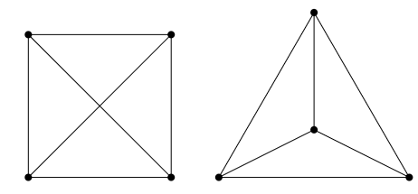
Planar Graph
Planar Graph Coloring is the example of absolute approximation algorithm.
Planar Graph Coloring : To determine the minimum number of colors needed to color a planar graph G = (V, E).
Problem: Coloring of the vertices of a graph such that no two adjacent vertices have the same color
Goal: minimize the number of color used
A graph is planar if it can be represented by a drawing in the plane so that no edges cross. Find which is planar??

Slide 10
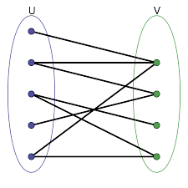
Planar Graph
Algorithm Acolor (V, E)
// Determines an approximation to the minimum number of colors needed to color a plan graph.
{
if V = Ф return 0;
else if E = Ф return 1
else if (G is bipartite) return 2;
else return 4.
}
It is known that every planar graph is four colorable
Worst case Time Complexity = O(|V|+|E|) to find whether a graph is bipartite.

Slide 11
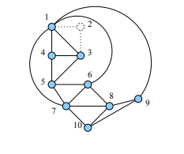
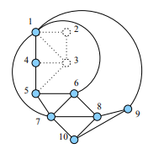
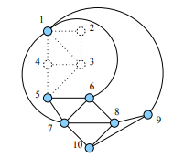
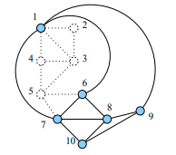
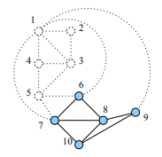
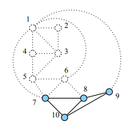
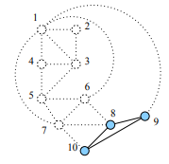
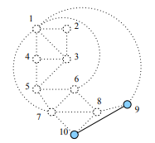
Example Planar Graph-1

Slide 12
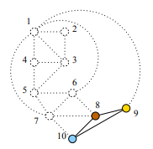
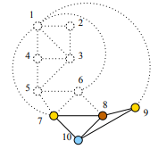
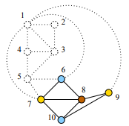
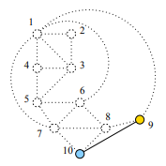
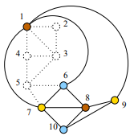
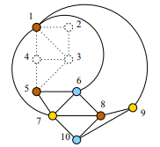
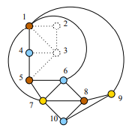
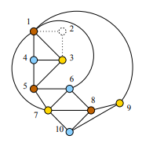
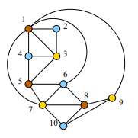
Example Planar Graph-1 - CONTD

Slide 13
Maximum Program Stored Problem (MPSP)
Goal: Let there be n programs and two storage devices, two disks with storage capacity of L each.
Let li be the amount of storage needed to store the ith program.
We need to determine the maximum number of these n programs that can be stored on the two disks without splitting a program over the disks.
Theorem : Partition α Maximum Programs Stored Problem.
Proof : Let {a1, a2, … ,an} define an instance of the partition problem. We can assume Σai = 2T for 1≤ i ≤ n. This is equivalent to the instance of maximum Programs Stored Problem for which L = T and ai = li for 1≤ i ≤ n. Clearly {a1, a2, … ,an} has a partition iff all n programs can be stored on the two disks.

Slide 14
Algorithm for MPSP
Algorithm Pstore(l, n, L)
// assumes that li ≤ li+1, 1 ≤ i ≤n.
{
i = 1; for j = 1 to 2 do
{
sum = 0;
// amount (part) of disk j already
// assigned
while (sum + l[i]) ≤ L do
{
write (“store program”, i, “on disk”, j);
sum = sum + l[i];
i= i + 1;
if i> n then return;
}
}
}

Slide 15
MPSP –Complexity
By considering programs in order of non-decreasing storage requirement li, we can obtain a polynomial time absolute approximation algorithm.
Pstore assumes l1≤ l2≤ … ln and assigns programs to disk1 so long as enough space remains on disk1.
Then it begins assigning programs to disk2.
Time complexity of this approximate algorithm is O(n) in addition to O(nlogn) time for sorting the programs into non-decreasing order of li.
Thus we can get the approximate solution in polynomial time i.e. O(nlogn) against exponential time optimal solution to the problem .

Slide 16
MPSP Example 1
Consider the following instance for Pstore :
{a1, a2, a3, a4, a5, a6} = {1, 2, 5, 8, 10, 14} and L = 20.
ρ = 6 ≥ F*(I) when one disk of size 2L is considered.
F*(I) ≤ 6 Partitions {1, 5, 14} & {2, 8, 10}
F^(I) = 5 using Pstore (two disks of size 20 each) {1, 2, 5, 8} & {10}
|F*(I) – F^(I)| ≤ 1

Slide 17
MPSP Example 2
Let L = 10, n = 4 and (l1, l2, l3, l4) = (2, 4, 5, 6).
Procedure PSTORE will store programs 1 and 2 on disk 1 and only program 3 on disk 2.
An optimal storage scheme stores all four programs. One way to do this is to store programs 1 and 4 on disk 1 and the other two on disk 2.

Slide 18
Thank you

